Slide 1
Cloud Native Culture- PoV
Karen Perez Diaz
July, 2021

Slide 2

Business Opportunity
Shifting to a Cloud Native culture is a major opportunity for CVS Health to speed innovation in order to gain market growth, mitigate risk and optimize our business technology and processes
Business Opportunity
Market Growth | Reduced time to market and Innovation Readiness by rapidly bringing disruptive ideas to life and capture new market niches ahead of the competition, with measurements to empirically assess ideas’ impact
Risk Mitigation | Resiliency and security. Well architected solutions decouple themselves from the underlying infrastructure and follow a zero trust security model Deployment confidence thanks to highly automated delivers which reduce the fear of change
Cost Reduction | Optimized high value models that focus on adding value to the business Elastic cost models where solutions are designed to use only the resources they need

Slide 3
What is Cloud Native? With so many definitions out there, it is difficult to align on a definition and scope
Cloud Native from an Applications perspective:
Redhat: “If an app is "cloud-native," it’s specifically designed to provide a consistent development and automated management experience across private, public, and hybrid clouds.”
IBM: “A cloud native application consists of discrete, reusable components known as microservices that are designed to integrate into any cloud environment.”
Cloud Native from an Approach / Culture perspective:
Cloudhealthtech.com: Cloud Native is an approach to building and running an application that exploits the advantages of the cloud delivery model. This doesn’t mean cloud native applications can’t be moved seamlessly between infrastructures, but generally, they’re architected to be platform-specific.
Cloud Native is structuring teams, culture, and technology to utilize automation and architectures to manage complexity and unlock velocity.

Slide 4
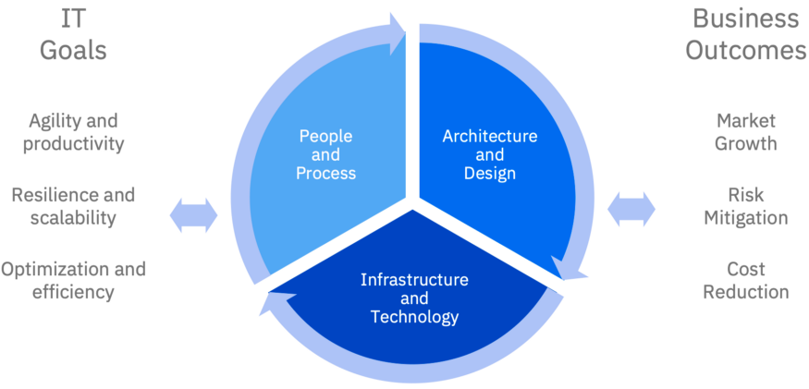
What do we mean by a Cloud Native Culture?
Our Definition: Cloud native is structuring teams, culture, and technology to utilize automation and architectures to manage complexity and unlock velocity. It is a self-service approach to building and running applications that exploits the advantages of the cloud delivery model
Cloud Native needs to be defined from 3 perspectives:
Infrastructure and Technology: Platforms that abstract complexities of the infrastructure.
Architecture and Design: Solutions that make best use of the infrastructure abstractions
People and Process: Automation of development, operations and business processes, and increasing autonomy of development teams

Slide 5
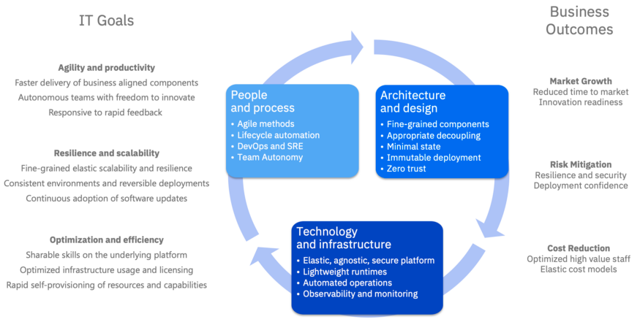
Technology alone cannot attain business outcomes We need an alignment between IT Goals and Business Outcomes

Slide 6
Cloud Native: Infrastructure
As cloud platforms and concepts have matured, the cloud in cloud native implies a greater abstraction from the underlying infrastructure.
Self-provisioning: Requisition of new virtual resources (servers, storage, networking) instantly
Elasticity: Automatically scale resources (and their associated costs) up and down based on demand
Auto-recovery: Resources are designed to recover from failures without intervention, and with minimal impact on service availability.
Immutable deployment — e.g. container image based deployment
Declarative provisioning — Infrastructure as Code (IaC) providing a to-be state
Runtime agnostic — The platform sees components (e.g. containers) as black boxes, with no need to understand their contents
Component orchestration — Enable management (monitoring, scaling, availability, routing etc.) through generic declarative policy and provisioning.

Slide 7
Cloud Native: Architecture and Design
Minimize statefulness
Reduce dependencies
Have well-defined interfaces
Are lightweight
Are disposable
Apply a microservice approach
Write components that can scale horizontally
Take advantage of open source technologies to leverage community efforts
Designing our solutions to ensure, that they can scale horizontally, and that they can work with the auto-recovery mechanism. It is here that cloud-native overlaps most with microservices concepts.
This includes for example writing components that:
*But, each of these decisions comes with corresponding process and organizational decisions needed to support the technology decisions.

Slide 8
Cloud Native: People and Processes
When we work with the above assumptions and decisions about the architecture and underlying infrastructure, it provides us opportunities to radically change the way we handle people and processes.
Implications from a microservices approach:
Build your services in small, autonomous teams
Use agile methods and apply DevSecOps principles to all development processes -> gain the E2E feedback on delivery + continuous integration and continuous delivery/deployment (CI/CD))
DevOps requires you to adopt automated testing, test driven development, and strongly leads you toward trunk-based development. The desire to minimize testing cycles might further lead you to explore changing the way you align people to work
Effect of container technology on required skillsets, roles, and processes:
Cloud infrastructure generally enables more to be achieved operationally using generic cloud platform skills (ex. Kubernetes), rather than specific runtime/product skills
this reduces the learning curve for people working across multiple technologies and enables broader role and knowledge sharing increasing efficiency and reducing cost
Immutable container images combined with IaC increase the consistency of deployment across environments
leading to shorter build/release cycle time, and increasing productivity
reducing testing / diagnostics costs and downtime

Slide 9
How can we adopt a Cloud Native Culture at CVS?
We need to take steps to make this a reality. These techniques can be applied incrementally as appropriate
How can we empower people and teams? How can we enable a self-service model?
How can we make Sandbox environments available to teams for learning / testing? How do we balance the pressure of deadlines with the need to ramp up and mature our teams?
How can streamline our E2E processes and move towards a more agile approach?
How does automation look like?
How can we create a new Greenfield SDLC that adopts a Cloud Native approach in practice?
Can we make any gradual changes to Brownfield SDLC to be more agile?
What is feasible and practical as of today and how would we develop an architectural runway to make this possible?

Slide 10
Next Steps
To start striving towards a Cloud Native Approach -
Publish PoV and disseminate core and benefits of adopting such an approach
Work with the Greenfield SDLC workstream group to delineate new process and steps
Work with the Brownfield SDLC workstream group to understand gaps and insert any catalysts that may push us forward
Help fund any initiatives that will help CVS accomplish the goal of going from Idea to Production Ready in weeks rather than months
Adopt cloud culture in our outsourcing model and manage vendors to do this, ensuring cloud culture is enforced through contracts, SLAs, etc.

Slide 11
Into Action.

